Slide 1
Header Files

Slide 2
C++: Namespace
Namespace
Similar to “import” in Java
Ex. List<Integer> numbers = new ArrayList<Integer>();
Requires Import javax.util.List and javax.util.ArrayList
Similarly,
Using namespace std;
Allows you to use “commands” such as cin, cout, etc.

Slide 3
C++: Namespace
Namespace
Global Namespace
If no namespace is used, all the code is in “global namespace”
No need to use “using” directive
To define your own namespace
Use “namespace my_name_space”
Now the code will be in this namespace

Slide 4
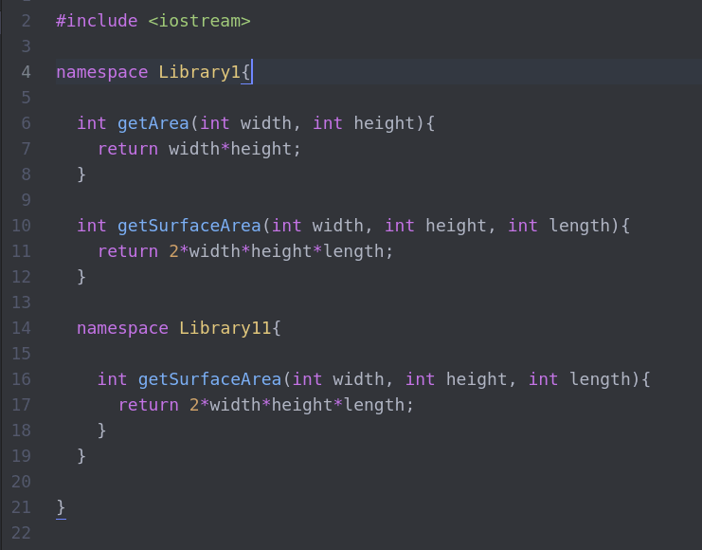
C++: Namespace
Example
Library1 namespace has method getArea and getSurfaceArea
Library11 namespace within Library1 has a method getSurfaceArea

Slide 5
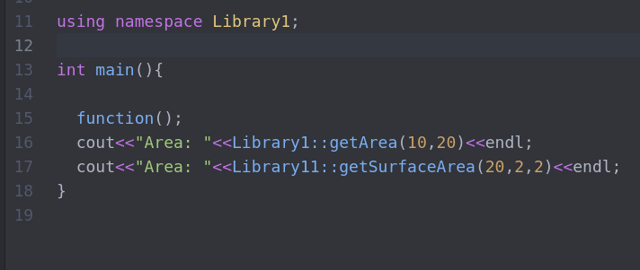
C++: Namespace
Example
To use the namespace,
using namespace <<namespace>>
Library11 namespace within Library1 has a method getSurfaceArea

Slide 6
C++: Header Files
Why ?
Previously, in a single C++ file (.cpp), we have:
Forward declared the function the program is going to define (interface)
Later, define the function to implement the functionality (implementation)

Slide 7
C++: Header Files
Problem
If the class is simple, mixing declaration and implementation is easy to manage
If NOT, its not good practice to write both declaration and implementation in the same file
Also, mixing declaration and implementation only allows one implementation.
Same file has to be modified for alternative implementation

Slide 8
C++: Header Files
Example
class Teacher{
private:
int SSN = 007;
protected:
string taxID = "MI5007";
public:
string firstName;
string lastName;
string email;
Teacher(string fname,string lname,string email){
this->firstName = fname;
lastName = lname;
this->email = email;
}
Teacher(const Teacher& obj){
firstName = obj.firstName;
lastName = obj.lastName;
email = "rks-"+obj.email;
}
void sendEmail() const{
cout <<"Test Email is sent to "<<getEmail()<<endl;
}
string getEmail() const{
return email;
}
};
Declaration
Definition
or
implementation

Slide 9
C++: Header Files
Example
class Teacher{
private:
int SSN = 007;
protected:
string taxID = "MI5007";
public:
string firstName;
string lastName;
string email;
Teacher(string fname,string lname,string email){
}
Teacher(const Teacher& obj){
}
void sendEmail() const{
}
string getEmail() const{
}
};
Declaration

Slide 10
C++: Header Files
Refer to Teacher.h
#include <iostream>
using std::string;
#ifndef TEACHER_H_
#define TEACHER_H_
class Teacher {
private:
string SSN = “007-007-0007”;
protected:
string taxID = "MI5007";
public:
string firstName;
string lastName;
string email;
Teacher(string fname,string lname,string email);
Teacher(const Teacher& obj);
void sendEmail() const;
string getEmail() const;
};
#endif /* TEACHER_H_ */
Declaration of Teacher class
Teacher.h

Slide 11
C++: Header Files
Implementation of Teacher
Teacher.cpp
#include “Teacher.h”
Teacher::Teacher(string fname,string lname,string email){
this->firstName = fname;
lastName = lname;
this->email = email;
}
Teacher::Teacher(const Teacher& obj){
firstName = obj.firstName;
lastName = obj.lastName;
email = "rks-"+obj.email;
}
void Teacher::sendEmail() const{
cout <<"Test Email is sent to "<<getEmail()<<endl;
}
string Teacher::getEmail() const{
return email;
}
};
Example

Slide 12
C++: Header Files
Header Files
Captures a class declaration
Acts as an interface for a class or function implementation
Always include a header file “*.h” NOT its implementation (*.cpp)

Slide 13
How does it work ?
At the compile time
Preprocessing – the #include directive is executed
Header file (.h) contents are included into the source file (.cpp)
source files are PASSED to the compiler
Compilation – the source files are converted into respective object files (.o)
Linker – the linker brings the object files together to generate the executable output
Header1.h
Header1.cpp
Header2.h
Header2.cpp
Header3.h
Header3.cpp

Slide 14
C++: Header Files
Guidelines
Keep a module’s or .cpp internal declarations out of the header file
Something specific to the implementation
How to check - Header file content should compile correctly by itself
Every header file should #include every other header file that the current header file requires to compile correctly
Avoid #include a .cpp file for any reason

Slide 15
C++: Header Files
Guidelines
Each module with its .h and .cpp file should correspond to a clear piece of functionality.
Header file contains declarations, function prototypes, and global variable extern declarations
Source file contains function definitions, global variable definitions and initializations
Always use “include guards” in a header file
#ifndef EXAMPLEHEADER_H_
#define EXAMPLEHEADER_H_

Slide 16
Thank You
Question, Comments & Feedback

